Slide 1
TEAM ACTA
Review 1
RedBull Basement Hackathon
29 August 2024

Slide 2
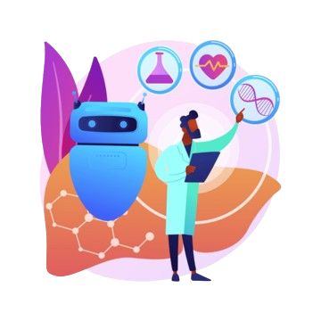
INTRODUCTION
Team Track:
Generative AI
Team Leader:
Virinichi (RA2311050010043)
Team Members:
Aditya Kulshrestha (RA2311033010065)
Arun Krishna Devalala (RA231130010320)
Maneesh Meka (RA2311003011610)
Sanya kapoor (RA2311027010011)

Slide 3
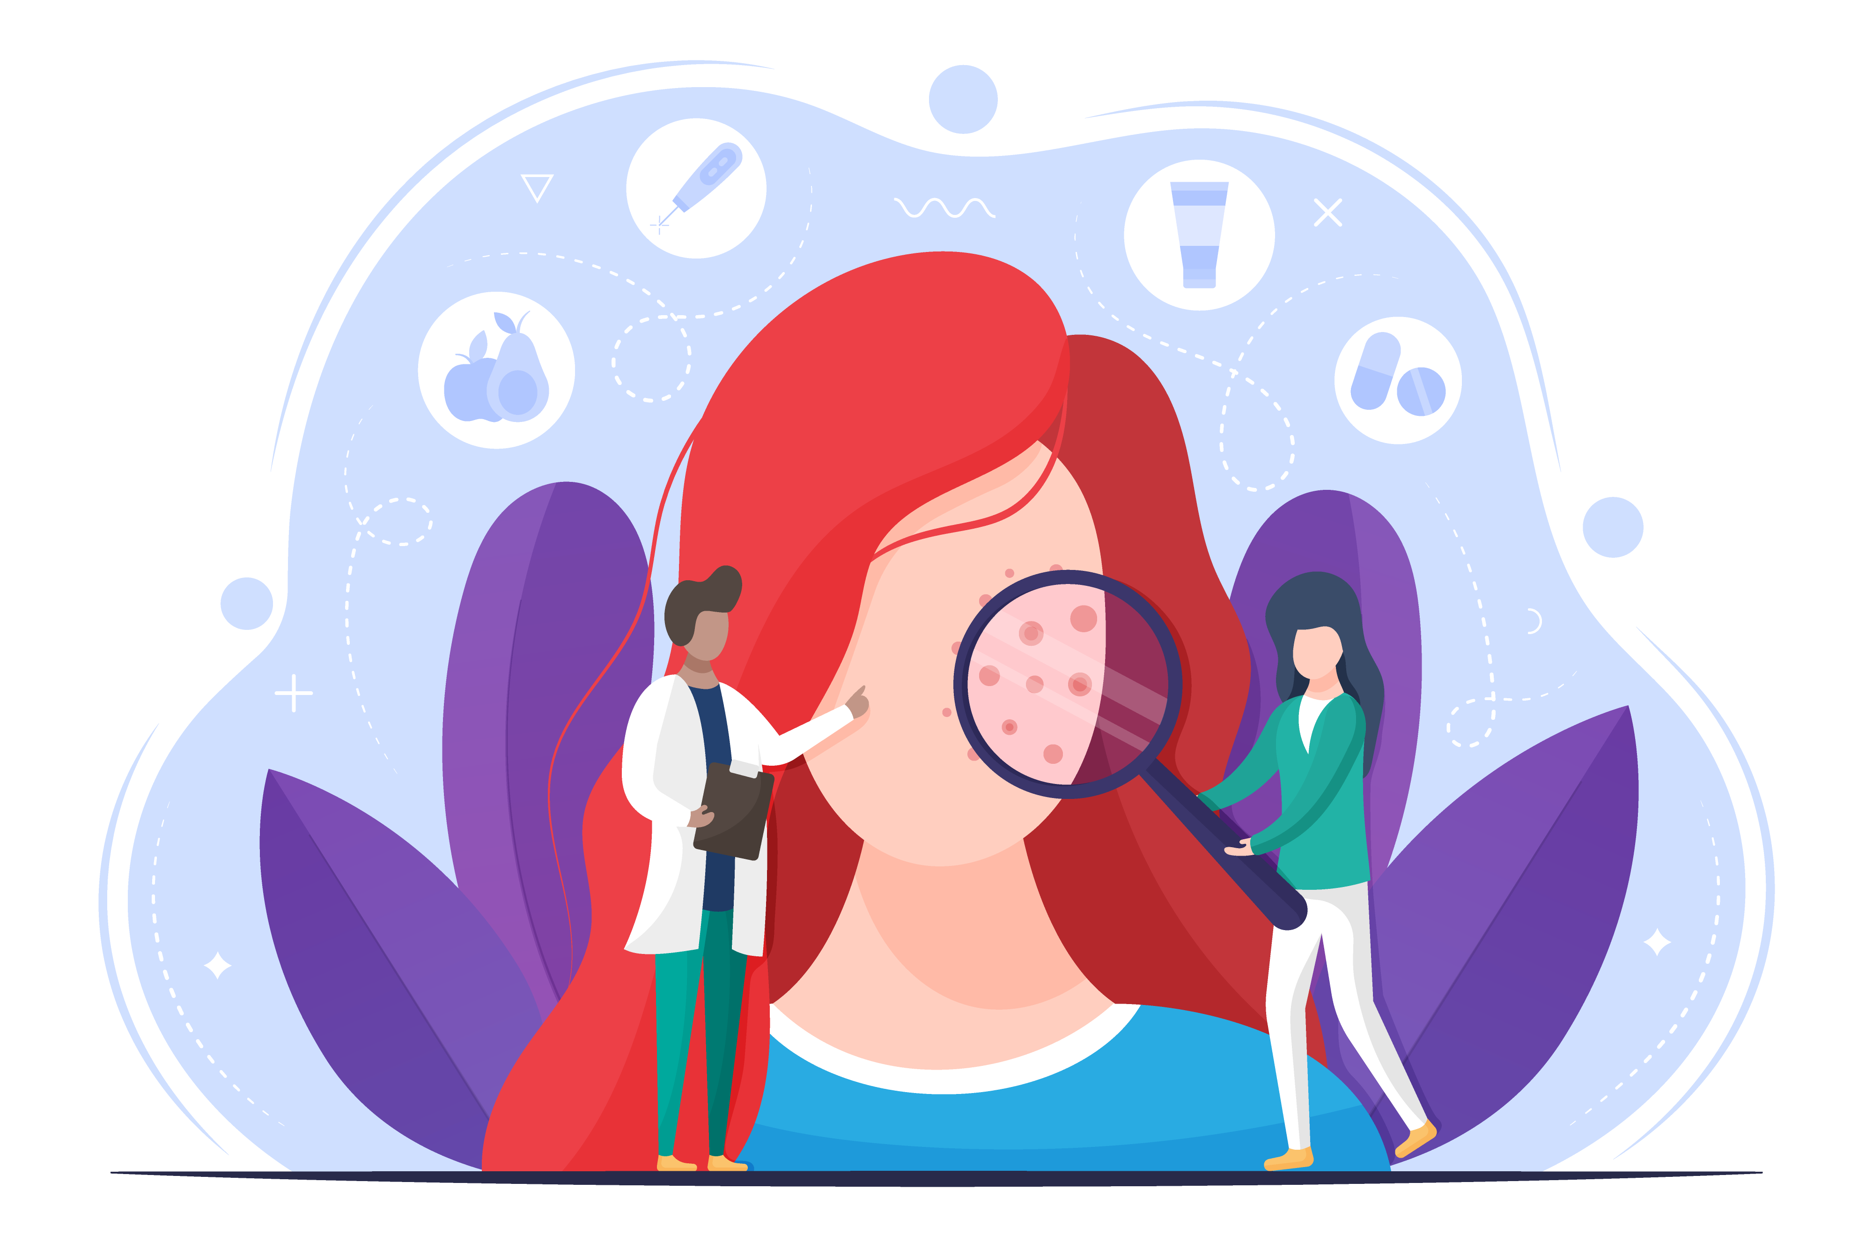
PROBLEM STATEMENT
Med-Gemini™ for Accessible Diagnosis of Skin Conditions

Slide 4

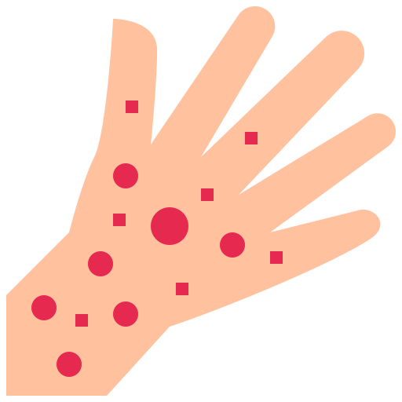
PROPOSED SOLUTION
A mobile app with Google Med-Gemini™ for patients in inaccessible areas to diagnose concerning skin conditions and get an alert to approach medical help. Patient groups also involve persons that find medical professionals intimidating and persons with an aversion to medical care. It also aims to save medical fees of from redundant doctor visits. The app suggests matching conditions, non-interfering treatments and prompts to narrow results. It learns from a history of diagnoses to increase accuracy.

Slide 5
THANK YOU
Please keep this slide for attribution.

